Slide 1
Merchant Taylors’ Company
A Hall Perspective
John Clink – Clerk

Slide 2
30 Threadneedle Street
Medieval Hall – scheduled ancient monument
Cold & draughty in the winter, hot and stuffy in the summer
Worked hard – Company events + 200 events for 40,000 guests per year
Expectation of even, comfortable temperature throughout year and fabulous food and wine.
Pressure to improve environmental footprint and awareness
Internal – direction from Court as part of long term Strategy
Internal – drive energy efficiency to save money
External – expectation of clients – energy, local produce, sustainability policy
External – reputation; Company in the leading pack

Slide 3
What have we done?
Notes:
Electricity is a relative success story: - the yellow line
2014 - Power optimiser and LED lighting (Note relatively little impact of 35.2 ton of C02 Emissions)
2019 – Switch to certified 100% renewable electricity supply contract (Note no increase in cost)
2020 – Installation of solar power onto the roof of the Great Hall to reduce annual running costs and provide a return over the 25 year lifespan of the installation)
Gas is less of a success story: - the red line
2012 - Condensing gas boilers installed. (Note: reduced the C02 emissions by 78.23 tons )
ONLY option now is switch heating and cooking @ the Hall from gas to renewable electricity.
UKPN Infrastructure:
Significant increase over and above the 400a 3 phs supply already entering the Hall.
The current UKPN infrastructure is already at capacity and further requests for additional power can not be accommodated without substantial capital investment into the infrastructure network.

Slide 4
Challenges
Rising temperatures – greater need and expectation of comfort cooling in dining areas and offices during warmer months
Catering is power hungry – need to switch away from gas
Existing UK Power Network at limit; need to plan
Drainage – installing attenuation tank now – will need better storm drainage in the next 20 years.
Waste
Space to separate waste types at Hall
Improve in-house waste management
Waste oil converted to biofuel

Slide 5
Merchant Taylors’ Company
A Hall Perspective
John Clink – Clerk

Slide 7
And, as Wax Chandlers
Our ‘trade’ based on beeswax and candles; we have a long term interest in bees and sustainability (we mark our 650th this year!)
BUT…...
The issue of pollinator decline is much broader than ‘just’ the honey bee
As a small Livery we are keen to work, and will benefit from working with, other Livery Companies; the issue affects us all. We are already working with the following Livery Cos:-
Gardeners
Information Technologists
Distillers
Architects
Join us/work with us, it should be fun!

Slide 8
Major decline in pollinators has taken place over the last 10 years
Food security; a third of our food is reliant on the work of pollinators
PLT stressing the importance of pollinators, biodiversity and green spaces/public realm in City
Plans for this year include, audits of City green spaces, a Citizen Science (educational) project and more formal launch in autumn; The Lord Mayor and Lady Mayoress have offered to host this in the Mansion House!
PLT aims to be more than ‘worthy’ there is interesting science, tasting, music and art opportunities
Visit; www.pollinatinglondontogether.com join in!

Slide 9
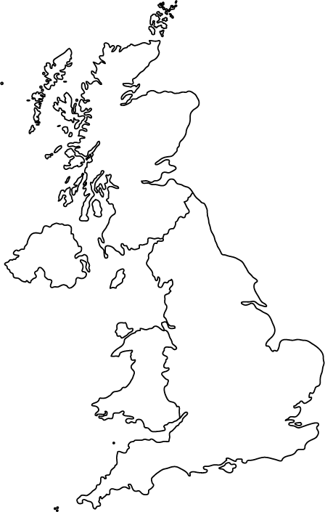
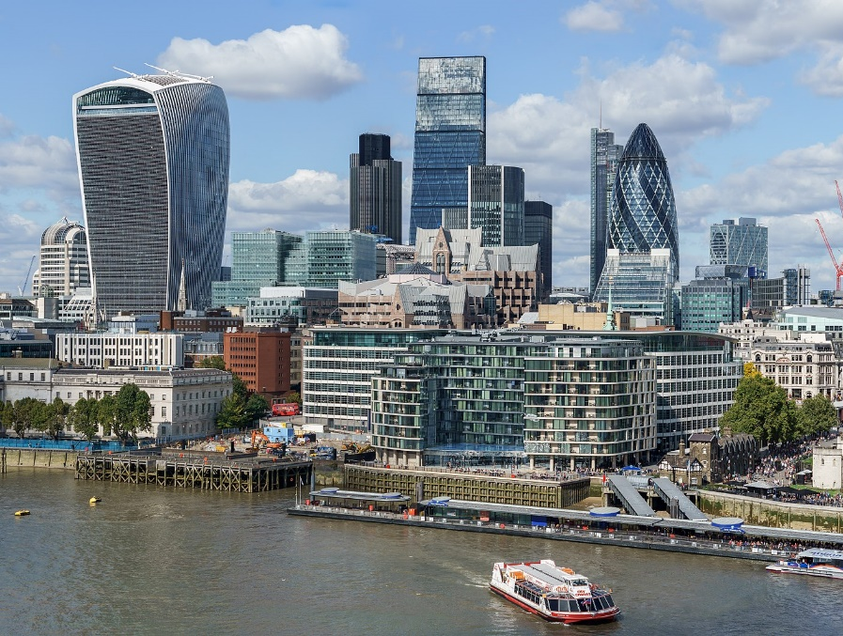
City Climate Action Strategy – Water Sector
Climate Change – Key Actions Fall Into Two Areas
1) Achieving net zero emissions – energy efficiency, renewable energy sources
2) Resilience to the impact of climate change – flood protection, SUDS, water efficiency
ACHIEVING NET ZERO IN THE CITY
INFLUENCE OF THE CITY ON THE REST OF THE UK AND GLOBALLY

Slide 10
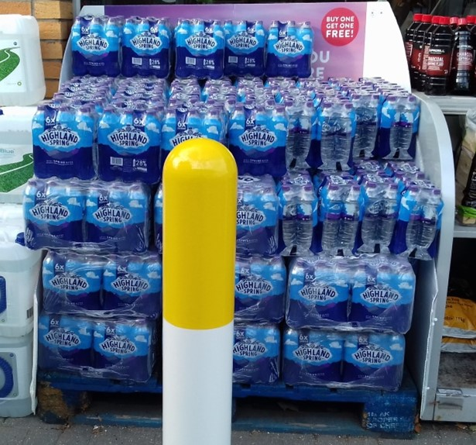
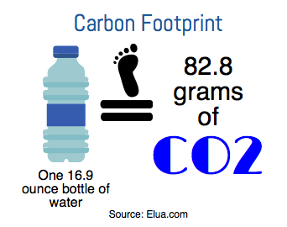
Achieving Net Zero In The Square Mile
Plastic Free City Campaign – Removing Plastic Water Bottles
IMPACT OF PLASTIC WASTE ON WILDLIFE AND THE ENVIRONMENT
Now well documented - Blue Planet, War on Plastic, etc.
CARBON FOOTPRINT
Approximate breakdown of CO2 footprint :-
Manufacturer and production 38%
Transportation 29%
Waste disposal 33%
One Less Campaign
Av Londoner buys over 3 plastic bottles of water a week. In the UK around 7.7 billion plastic bottles are purchased every year.
Based on a carbon footprint of 83 grams per bottle :-
7.7 billion bottles for UK total = over 0.5 million tonnes of CO2 per year
0.5 million City workers = 7,000 tonnes of CO2 per year

Slide 11
Supporting Climate Change Action Across The UK
ACHIEVING Net zero – KEY ACTIONS
The UK water industry is the UK’s 4th most energy intensive sector
It consumes 3% of the UK’s electricity, and
Generates 1% of carbon dioxide emissions
(Veolia Report – H2O27 Future-Proofing UK Water”)
Increased use of renewable energy – e.g. Solar panels,
Harnessing Biogas from sewage (UK sewage could generate over 1,000 gigawatt hours of electricity).
Adopting low energy use systems.
Climate Change Resilience – Key Areas
Improved Water Efficiency – Leakage Reduction, Efficient Use of Water, Water Reuse, Rainwater Harvesting
Improved Flood Resilience - Flood Protection, Sustainable Urban Drainage, Property Protection On Flood Plains
Extract From Bricks & Water Report By The
Westminster Sustainable Business Forum

